Slide 1
Unit 8
Presented by: Er.Sudan Prajapati

Slide 2
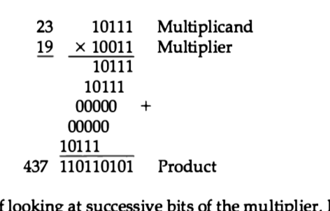
Multiplication Algorithms
Multiplication of two fixed-point binary numbers in signed-magnitude repre­sentation is done with paper and pencil by a process of successive shift and add operations

Slide 3
The process consists of looking at successive bits of the multiplier, least signif­icant bit first.
If the multiplier bit is a 1, the multiplicand is copied down; otherwise, zeros are copied down.
The numbers copied down in successive lines are shifted one position to the left from the previous number.
Finally, the numbers are added and their sum forms the product.

Slide 4
Hardware Implementation for Signed-Magnitude Data
When multiplication is implemented in a digital computer, it is convenient to change the process slightly.
First, instead of providing registers to store and add simultaneously as many binary numbers as there are bits in the multiplier, it is convenient to provide an adder for the summation of only two binary numbers and successively accumulate the partial products in a register.
Sec­ond, instead of shifting the multiplicand to the left, the partial product is shifted to the right, which results in leaving the partial product and the multiplicand in the required relative positions.
Third, when the corresponding bit of the multiplier is 0, there is no need to add all zeros to the partial product since it will not alter its value.

Slide 5
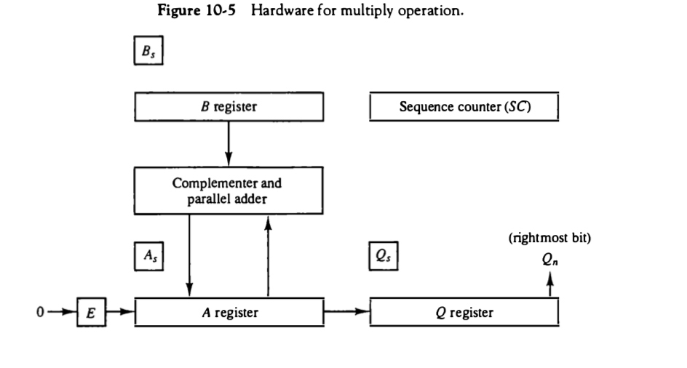

Slide 6
The hardware for multiplication consists of the equipment shown in Fig. plus two more registers.
The multiplier is stored in the Q register and its sign in Qs.
The sequence counter SC is initially set to a number equal to the number of bits in the multiplier.
The counter is decremented by 1 after forming each partial product.
When the content of the counter reaches zero, the product is formed and the process stops.
Initially, the multiplicand is in register B and the multiplier in Q.
The sum of A and B forms a partial product which is transferred to the EA register. Both partial product and multiplier are shifted to the right
. This shift will be denoted by the statement shr EAQ to designate the right shift

Slide 7
The least significant bit of A is shifted into the most significant position of Q, the bit from E is shifted into the most significant position of A, and 0 is shifted into E.
After the shift, one bit of the partial product is shifted into Qspushing the multiplier bits one position to the right.
In this manner, the rightmost flip-flop in register Q designated by Qn, will hold the bit of the multiplier, which must be inspected next.

Slide 8
Hardware Algorithm
Figure below is a flowchart of the hardware multiply algorithm. Initially, the multiplicand is in B and the multiplier in Q. Their corresponding signs are in Bs and Qs, respectively.
The signs are compared, and both A and Q are set to correspond to the sign of the product since a double-length product will be stored in registers A and Q.
Registers A and E are cleared and the sequence counter SC is set to a number equal to the number of bits of the multiplier.
assuming that operands are transferred to registers from a memory unit that has words of n bits. Since an operand must be stored with its sign, one bit of the word will be occupied by the sign and the magnitude will consist of n -1bits.

Slide 9
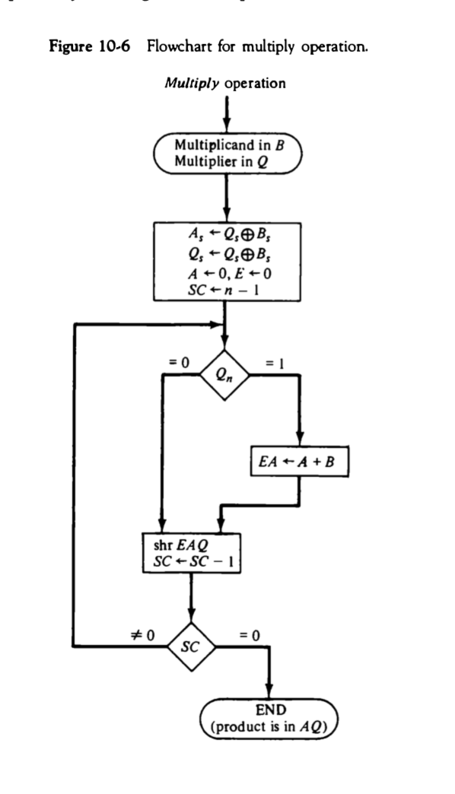

Slide 10
After the initialization, the low-order bit of the multiplier in Q, is tested.
If it is a 1 , the multiplicand in B is added to the present partial product in A .
If it is a 0, nothing is done.
Register EAQ is then shifted once to the right to form the new partial product The sequence counter is decremented by 1 and its new value checked.
If it is not equal to zero, the process is repeated and a new partial product is formed. The process stops when SC = 0.
Note that the partial product formed in A is shifted into Q one bit at a time and eventually replaces the multiplier.
The final product is available in both A and Q, with A holding the most significant bits and Q holding the least significant bits.

Slide 11
